Slide 1

C R I M E F O R E C A S T I N G

Slide 2

S E A T T L E F A C T S:
Known as the “Emerald City”, Seattle is the most populous city in Washington state.
Population: 600,000.
Is ranked 51st for the violent crime rate in the country..
In 2021:
Crime Rate: 690.85 per 100k residents.
Violent crimes increased by 20%.
As of Jan 31,2022:
Total crimes: 4,023.
Source:https://www.seattle.gov/police/

Slide 3

O V E R V I E W
BUSINESS PROBLEM
THE DATA
RESEARCH/MODELLING
RESULTS
BUSINESS RECOMMENDATIONS
NEXT STEPS

Slide 4

B U S I N E S S P R O B L E M
Team was hired by Seattle Police Department to determine a model that can be used to forecast future crimes counts in the city.
This model can help facilitate practical crime prevention solutions.
Can aid police personnel in optimal decision-making and resource management.

Slide 5

D A T A U N D E R S T A N D I N G
Source : City of Seattle Official Website
(https://data.seattle.gov/Public-Safety/SPD-Crime-Data-2008-Present/tazs-3rd5)
Dataset Details:
Rows: 962K
Columns : 17
Each row is a: Crime Data: 2010 - 2020
Columns: {Offense Start Date Time, Offense Parent Group,Crime against Category,offense code,Offense Report time}

Slide 6

D A T A F I N D I N G S:
Crime Against Category: Property
Major Category in Offence Group:
Larceny-Theft
Crime counts by each day: Friday
Crime by Groups: Group A
Crime Month: May

Slide 7
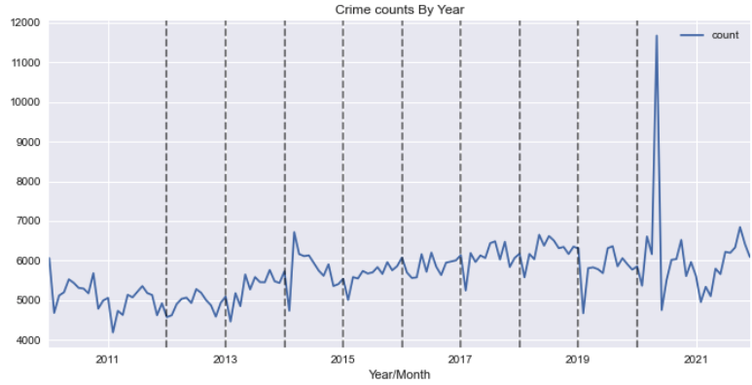

Slide 8

M E T H O D S U S E D:
Time Series Forecasting techniques:
ARIMA
Auto-ARIMA
SARIMA
PROPHET
DataSources:
https://www.advancinganalytics.co.uk/blog/2021/06/22/10-incredibly-useful-time-series-forecasting-algorithms

Slide 9

M E T R I C S:
METRICS: MAPE(Mean Absolute Percentage Error)
Lower MAPE percentage - Better the model.

Slide 10
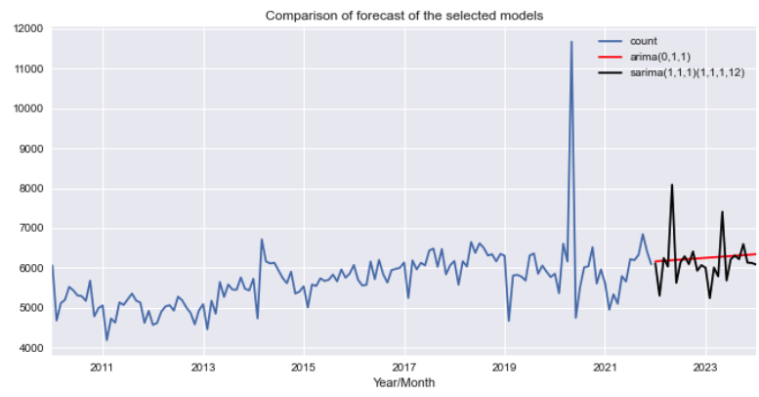
M O D E L R E S U L T S:

Slide 11
B E S T P E R F O R M I N G M O D E L:
SARIMAX(1,0,1)(0,1,2)12
Mean Absolute Percentage Error(MAPE) : 43.35%

Slide 12
C O N C L U S I O N
Does Monthly crimes in Seattle has an increasing Trend?
-Numbers are pretty stable with no clear trend till 2019,
-Concludes to allocate more resources on taking measures to control the increasing numbers.
Can our model explain the time related patterns?
-Model shows periodical patterns of 2 yrs..
-Patterns are carried on year by year showing correlations with each other.
-Model overall does a good job in explaining the information carried by the crime number time series.

Slide 13
R E C O M M E N D A T I O N S
One high spike in the series shows a spike which might be an anomaly.
The model might suffer from overfitting.
Using an ensemble of models can help in creating a persistent model.

Slide 14
W A Y F O R W A R D
Trying other Forecasting techniques like:
Exponential Smoothing
Artificial neural network
Explore the components of time series more thoroughly.

Slide 15

T H A N K Y O U
Namita Rana
Email:namitarana21@gmail.com
Github:https://github.com/namitarana1

